Slide 1
Clustering Challenge
Team 3 - Thomas - Becode Liege

Slide 2
The Mission
Find Chipotle locations to live your ideal Chipotle lifestyle by clustering the Chipotle dataset.

Slide 3
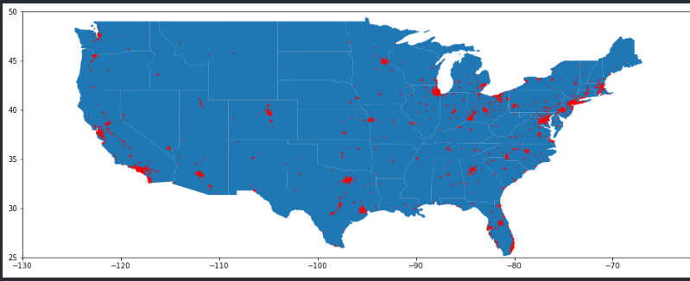
Plot the initial locations

Slide 4
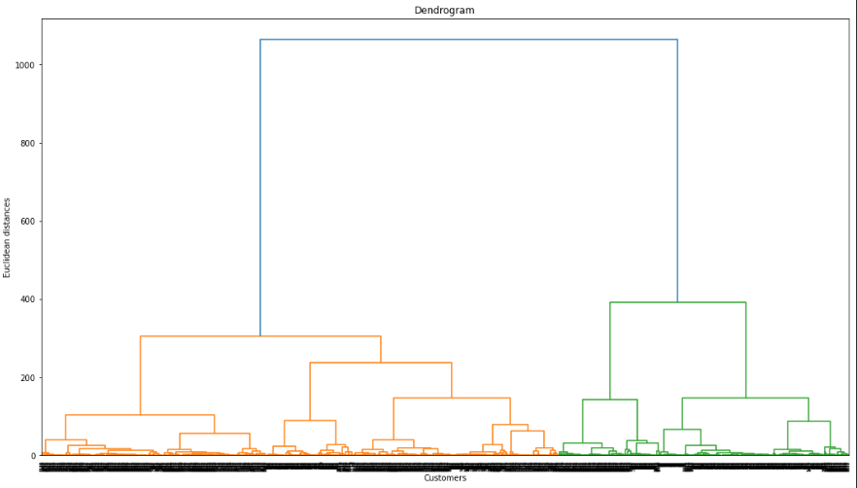
First Dendrogram
Hard to read!

Slide 5
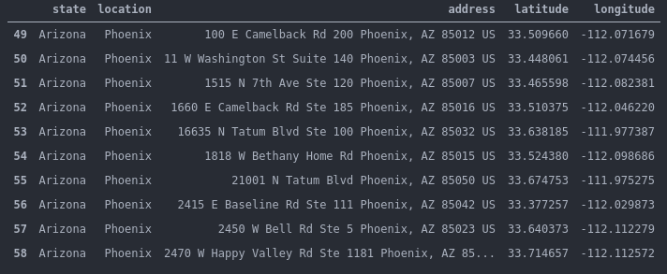
Preprocessing to get the highest density locations with a threshold of 10 chipotles

Slide 6
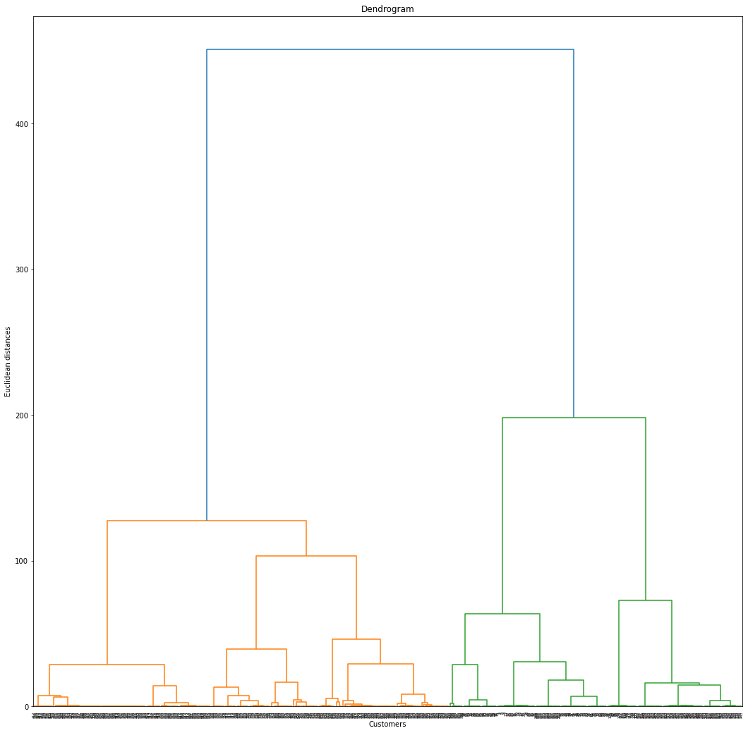
Interpretable Dendrogram

Slide 7
KMeans
Instantiate
Fit
Get methods
Basics arguments:
n_clusters=24,
init='k-means++.
Fitting the model with y:
y = df[['longitude','latitude']]
After fit, we get:
cluster_centers
y_clust = y.join(cluster_labels.to_frame())

Slide 8
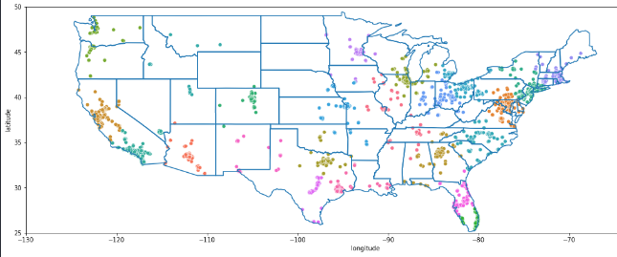
Clustered locations using KMeans

Slide 9
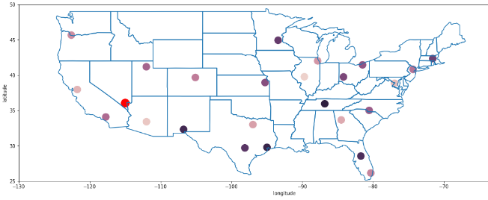
Chosen point per clusters
Chosen point

Slide 10
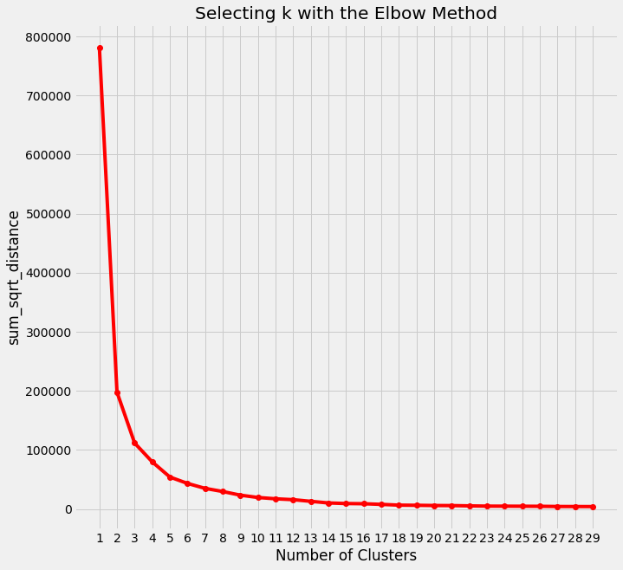
Elbow Curve to evaluate the number of clusters choices :

Slide 11
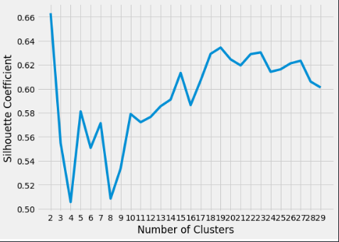
Silhouette Curve

Slide 12
Using KMeans with optimal n_clusters
Using the first estimation of the number of clusters based on the lecture of the Dendrogram :
Silhouette score = 0.7238236104415042
Using the optimal number of clustering based on the Elbow curve :
Silhouette score = 0.7021313410944304

Slide 13
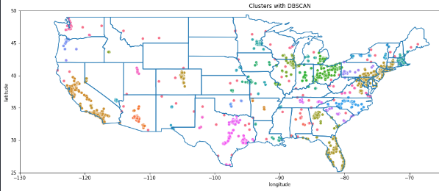
DBScan
Very bad score
(0.347)

Slide 14
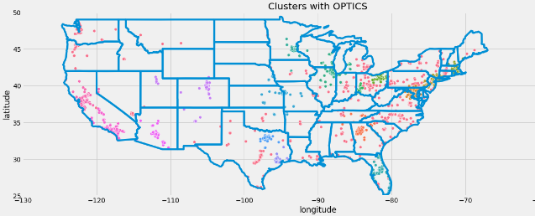
OPTICS
Fairly good score
(0.411)

Slide 15
Conclusion
Score max.
KMeans is the best method to use and
the best location to eat at Chipotles is ‘’My home’’ or Southeast Washington, Washington, District of Columbia 20020

